Slide 1
Presents
OO Programming with Java
Exceptions
Notes:
Exceptions
Module 16

Slide 2
Learning Objectives
Runtime Problems
try/catch
Checked Exceptions
Throwing Exceptions
Custom Exceptions
Defining Exceptions
Notes:
The basic concepts of exception handling are explained in this chapter.

Slide 3
Introduction
One way of handling problems in your code is to have your methods return a special value to indicate that something has gone wrong.
In C, for example, it is common to return null or a negative integer when an error occurs.
But what if your code could legitimately return those things? Or has a void return? And how does returning null allow you to indicate the nature of the error?
  In C, the runtime has a single, global, variable to hold an error code, which can be set by library routines and checked by application code.
With this technique, the return value from each method call and/or the global error code must be checked.

Slide 4
Introduction
In Java we can also use a try/catch block to process faults.
Faults are handled by a simple class called Exception.
When a method encounters an error, it uses the throw keyword to create a new instance of an Exception class. Then it passes this object back to the code that called the method.

Slide 5
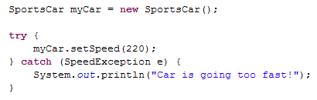
An Example
Here we see a method, setSpeed(), wrapped in a try/catch block. In the next slide we’ll see how setSpeed() throws SpeedException on an error.
Notes:
myCar.setSpeed() ; is known as suspicious code since it might thow an Exception.

Slide 6
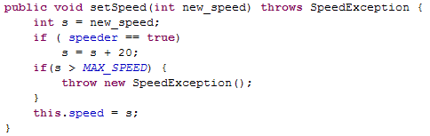
An Example (continued)
Notice the throws clause, which has been added after the method signature.
An exception is thrown ONLY if the calculated speed is greater than MAX_SPEED. When this happens the method returns immediately. The last line of the method is not executed.

Slide 7

An Example (Concluded)
Creating the SpeedException class is very simple; It just extends the Exception class.
Your exception classes are typically kept in their own packages.

Slide 8
Different Types of Exceptions
In addition to Exceptions, which can generally be handled in code, there are certain error conditions for which there is no real solution.
Suppose that the computer your program is running on experiences a hardware problem like a disk failure. There’s nothing your program can do to fix this.
For these situations, Java provides the Error class. An Error object represents a fault that your code cannot recover, i.e., hardware memory error.

Slide 9
Runtime Problems
The runtime problems that cause exceptions fall into four broad categories:
  Code or Data Errors
  Standard Method Exceptions
  Throwing Custom Exceptions
  Java Errors
The Java language represents exceptions as objects, all of which belong to the java.lang.Throwable class or one of its subclasses.
Notes:
An exception in Java is an object that is created when an abnormal situation arises in the program. This exception object has data members that store information about the nature of the problem.
The exception mechanism is built around the throw-and-catch paradigm. To throw an exception is to signal that an exceptional condition has occurred. To catch an exception is to take appropriate action to deal with the exception. An exception is caught by an exception handler.
The runtime behavior of the program determines which exceptions are thrown and how they are caught.

Slide 10
Throwable hierarchy
Throwable
Exception
Error
InterruptedException
RuntimeException
OutOfMemoryError
NullPointerException
DivideByZeroException
Notes:
The Throwable class is the superclass of all errors and exceptions in the Java language. Only objects that are instances of this class (or one of its subclasses) are thrown by the Java Virtual Machine or can be thrown by the Java throw statement. Similarly, only this class or one of its subclasses can be the argument type in a catch clause.

Slide 11
Checked and Unchecked Exceptions
Whenever you invoke a method that could throw a checked exception, the compiler will insist that you handle the exception.
Checked exceptions are ones you want to force your client code to address.
Checked exceptions have to be declared in throws clauses.
Subclasses of Exception except RuntimeException and its subclasses are checked exceptions.
Unchecked exceptions do not carry compiler enforced constraints.
Notes:
The method charAt() in the String class throws an unchecked exception. You don’t want to force all methods that use charAt() to explicitly handle the exception.
If there were no unchecked exceptions, every method would have to deal with the possibility of an OutOfMemoryError. This would make your code very unwieldy.

Slide 12
Checked versus Unchecked
Throwable
checked
unchecked
Exception
Error
CustomException
RuntimeException
OutOfMemoryError
NullPointerException
DivideByZeroException
Notes:
The Throwable class has two subclasses:
Error
Exception
An Error is a subclass of Throwable that indicates serious problems that a reasonable application should not try to catch. Most of these errors are abnormal conditions.
The class Exception and its subclasses are a form of Throwable that indicates conditions that a reasonable application might want to catch.

Slide 13
Built In Exceptions
Many of the core Java classes throw exceptions.
The exceptions that a method throws are automatically included in the standard documentation.
When a method declares that it throws an exception, any code which calls that method must handle the exception with a try/catch block or by throwing the exception again.
In the API, you will find many exception classes. You can use these or create your own.

Slide 14
Throwing Exceptions from main()
The main method is the starting point for your Java programs.
If you throw exceptions from main:
public static void main (String[] args)
throws FileNotFoundException {
The Exception – if and when it occurs – will be handled by the Java runtime environment.
In this case, the JRE will just print out a Stack Trace and abort.

Slide 15
The Stack Trace
Here is a very simple stack trace:
Exception in thread "main"
com.lq.exceptions.SpeedException
at com.lq.cars.Car.setSpeed(Car.java:12)
at com.lq.cars.Car.main(Car.java:19)
The information in this stack trace is reasonably straightforward. It can become more challenging with nested exceptions.
In this example, we see that a SpeedException was thrown at line 12 of Car.java in the method setSpeed. We can also see that setSpeed was called by line 19 of the main method.

Slide 16

Working with try-catch
We catch exceptions that have been thrown:
If setSpeed throws a SpeedException, Java will skip any remaining code in the try block and execute the code in the catch block instead.
The exception object e can be referenced inside the catch block.

Slide 17
Multiple catch Blocks
All exception classes inherit from Exception.
Java uses this fact to decide which catch block to execute when an error is thrown.
Java will use the first catch clause whose Exception type IS-A the type that was thrown.
Catching Exception acts as a "catch-all" for any unhandled exception (not Error or Throwable).

Slide 18
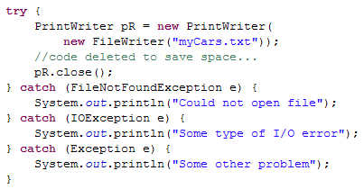
Multiple catch Blocks
To handle different types of Exceptions you can arrange multiple catch blocks underneath your try block:

Slide 19
The finally block
There is a significant error in our code. If there is an error when writing the PrintWriter, it will be left open.
After catch blocks we can include a finally block.
A finally block can follow:
  A single try statement without any catch blocks
  The last catch block in a try-catch statement
The code in the finally block will be executed whether or not there is an exception. If an exception occurs, the finally block is executed after the code in the catch block. Finally always executes!
Finally is used for recovering resources and/or cleaning up following the execution of a set of statements.

Slide 20
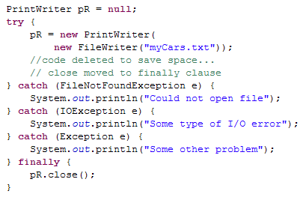
Correcting with the finally Block
Here is the corrected version of the code, with the call to close() moved to the finally block, so that it always runs.

Slide 21
Java Programming Language Updates
The need for finally is so common, and so oft-missed, that Java 7 adopted a page from Python, and introduced the try-with-resources statement
The try-with-resources statement is a try statement that declares one or more resources. A resource is as an object that must be closed after the program is finished with it.
  The resource must implement the AutoClosable interface.
  Resources are anything that need to be cleaned up. Although the method is close(), it could be a close, a release, or any other aspect that means we’re finished using it.
Notes:
A try-with-resources statement can have catch and finally blocks just like an ordinary try statement. In a try-with-resources statement, any catch or finally block is run after the resources declared have been closed. This sutomatic closure is the real benefit of the try-with-resources type try block;

Slide 22
Java Programming Language Updates
Let’s rewrite the previous example, using try-with-resources:
  try (PrintWriter pR = new PrintWriter(new FileWriter("myCars.txt"))) {
  … code omitted for clarity …
  } catch (FileNotFoundException e) {
  // Despite its name, this is also thrown when
  // a file exists but can't be open for write
  out.println("Can't open myCars.txt for write.");
  e.printStackTrace();
  } catch (IOException e) {
  e.printStackTrace();
  }
When the entire try-catch ends, pR.close() will be automatically called.
Notes:
A try-with-resources statement can have catch and finally blocks just like an ordinary try statement. In a try-with-resources statement, any catch or finally block is run after the resources declared have been closed. This sutomatic closure is the real benefit of the try-with-resources type try block;

Slide 23

Java Programming Language Updates
Sometimes, we want to handle the multiple exceptions in the same manner.
Rather than force us to repeat multiple catch clauses differing only by their exception type, Java 7 adopted another Python feature.
Catching Multiple Exception Types and re-throwing Exceptions with Improved Type Checking
  The catch clause specifies the types of exceptions that the block can handle, and each exception type is separated with a vertical bar (|).
Notes:
Added in Java 7

Slide 24
Throwing Multiple Exceptions
A method that can throw multiple checked Exception objects must indicate each type of Exception.
The example that follows uses multiple checked exceptions to show one way of dealing with errors coming from different sources.

Slide 25
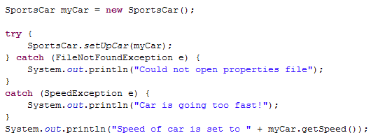
Throwing Multiple Exceptions
First we see the user code that is attempting to set up a new Sports Car using a speed defined in a Properties file.

Slide 26
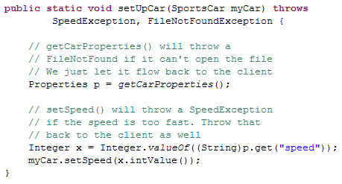
Throwing Multiple Exceptions
The setUpCar method can potentially throw two different types of Exceptions.

Slide 27
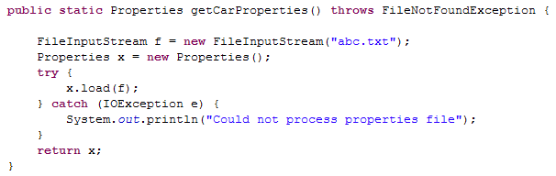
Throwing Multiple Exceptions
The getCarProperties method ignores problems opening the file but will catch an IOException if the load fails.

Slide 28
Using Exception
It is possible (but inadvisable) to do this:
try {
myCar.setSpeed(1000);
}
catch(Exception e){/* notice that there's no code here */ }
DON’T DO THIS! It tells the user of the method nothing about the nature of the error that is thrown by the method!
What if they don’t have the source?
How will the client know how/what has occurred?

Slide 29

Writing Custom Exceptions
Java provides you with the capability to extend any member of the Exception hierarchy to build your own custom Exception classes.
Typically these will just be marker classes. They are differentiated by name only. It is possible to add your own data and methods as well, and you will often want constructors that allow you to provide or generate a message.
Notes:
Marker classes contain no methods.

Slide 30
Dealing with Error Objects
Java provides a rich set of Throwable objects to announce the presence of specific Errors in the application runtime environment.
Some of these really can’t be addressed programmatically, so trying is usually a waste of time.
try
{
// do something here
}catch (OutOfMemoryError oe){
System.gc(); // flag the garbage collector to run
System.out.println("wow! I didn’t think of that!!!");
}

Slide 31
Deal with Exceptions Locally
An ideal situation is to deal with exceptions in the method where they could be thrown.
While this isn’t always possible, it’s a general rule of thumb in object-oriented system development.
Data and functionality are localized in objects so why not error handling?

Slide 32
Exceptions are Exceptional!
An Exception should be used only in exceptional conditions, not as a result of normal control flow.
An exception should typically be used to indicate and address recovery in the presence of a fault.
Reasons to Believe!
  They are performance expensive
  Exception propagation is often referred to as an “uncontrolled goto” – any idea why?

Slide 33
What is Exceptional?
A program tries to open a file that does not exist or the file is not in the expected format
A network connection may not exist or the connection may be interrupted
The end of a file might be reached sooner than expected
Accessing an element that is outside the bounds of an array
Integer division by zero

Slide 34
Designing with Exceptions
When we introduced OO design, we chose to leave out any discussion of exception handling. We felt it would make the topic overly complicated.
However, when designing a Java system, it is normal to create a set of Exception classes for handling the various error conditions the system will encounter.
Since the Exception classes are ordinary Java classes, they can be designed using the same techniques used for the rest of the system.

Slide 35
Summary
In Java, we use a try/catch block to process faults.
Errors are handled by a simple class called Exception.
Catch blocks handle the Exception that has been thrown.

